Slide 1
Machine Learning Workshop

Slide 2
Supervised Machine Learning

Slide 3
Regression
Predicting continuous values.
Example: you are given a dataset of sales at each day at a store and your task is to predict the sales next year

Slide 4
Classification
Predicting classes or discreate values.
Example: given the content of a mail predict if it is ham or spam.
Given the size of a tumor predict if it is cancerous or benign.

Slide 5
Linear Regression
Linear Regression is basically fitting a straight line through your data
F(x) = WX + b
X = Input
W, b = parameters of the model
F(x) = output (prediction)

Slide 6
Cost Function
Cost Function is the measure of the performance of a model.
The main objective of a machine learning model is to minimize the given cost function.

Slide 7
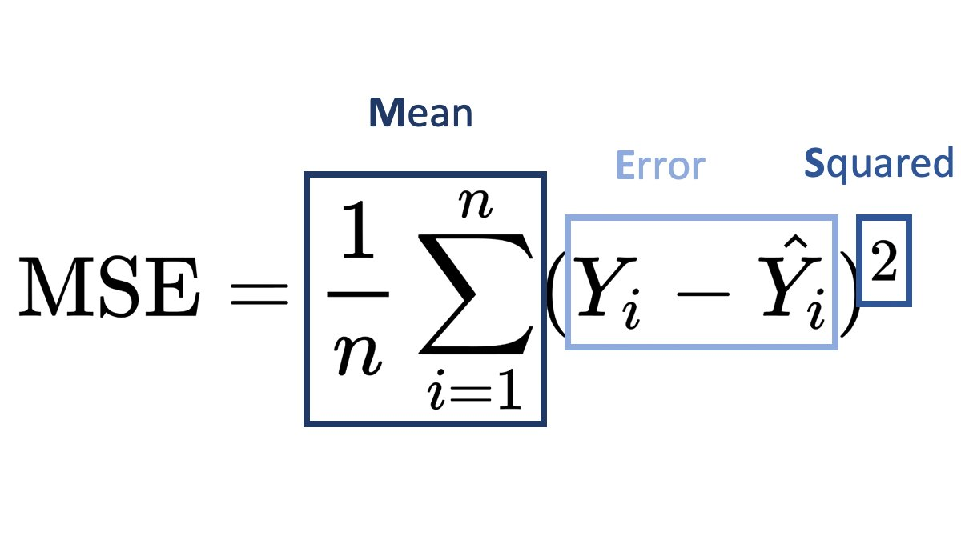
Mean Squared Error
Ŷ – model prediction
Y – Actual value
n - Number of examples (rows in dataset)
i – ith example

Slide 8
What does a cost function look like?

Slide 9
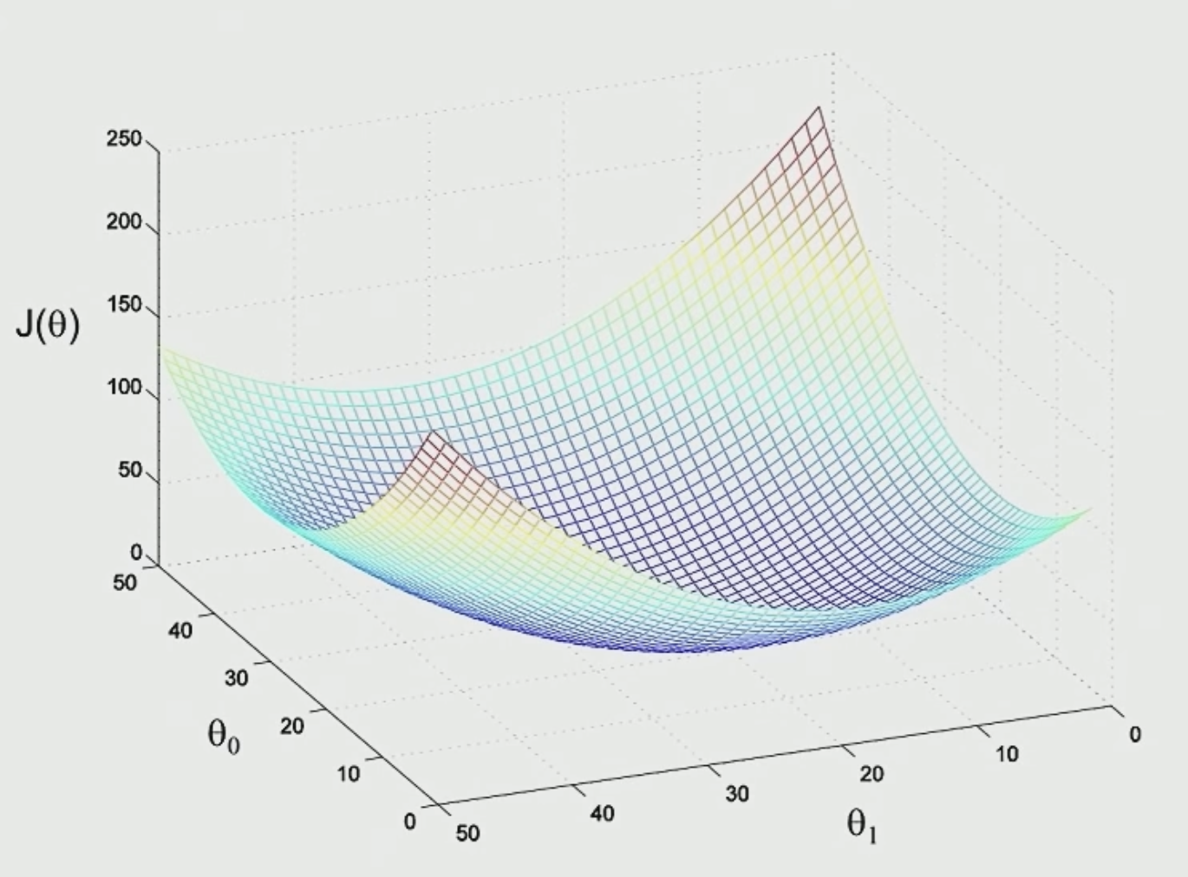
Mean Squared Error Cost Function

